Slide 1
Interfacing Gas sensor(MQ-2) with lpc1769 Project: iot based smart weigh scale and tank monitor
Submitted by :
group #5
Krutika fanse
Ankit patel
Gurvinder singh

Slide 2
contents
Description of LPC1769
Specification of MQ2 sensor
Working of MQ2
Sensitivity characteristics
Schematic Diagram
Steps to Interface MQ-2 gas Sensor
Code Snippets
References

Slide 3
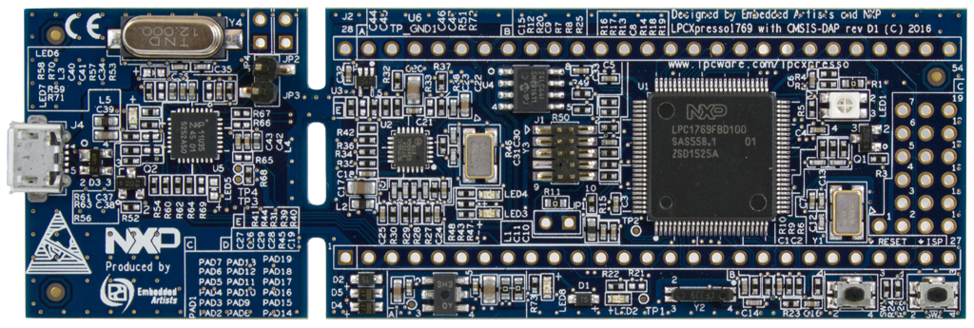
Description of lpc1769
32-bit ARM Cortex-M3 Microcontroller.
Operates at CPU frequencies of up to 120 MHz.
512 kB of flash memory, 64 kB of data memory
Ethernet MAC, USB Device/Host/OTG interface
8-channel general purpose DMA controller
4 UARTs, 2 CAN channels, 2 SSP controllers, SPI interface, 3 I2C-bus interfaces.

Slide 4
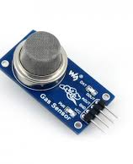
Specifications of mq2
MQ-2 is widely used gas sensor in MQ series.
It is a Metal Oxide semiconductor also know as Chemiresistor.
Its operating voltage is 5V and draws the power of 800mW.
It can detect the flammable gases, smoke and alcohol concentration ranging from 200ppm to 10000ppm.
It provides the analog as well as digital output.

Slide 5
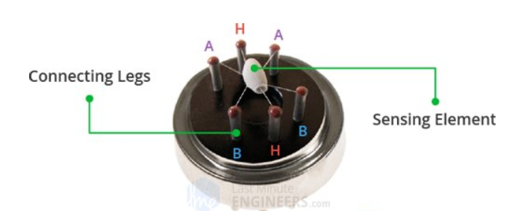
Working of mq-2
This is the internal structure of the sensor after the mesh covering is removed.
The two leads (H) responsible for heating of sensing element.
The leads (A and B) are connected to the body of sensing element using platinum wires.
So (A and B) senses the small change in current passing through the sensing element
The is sensing element is made of Aluminium oxide.

Slide 6
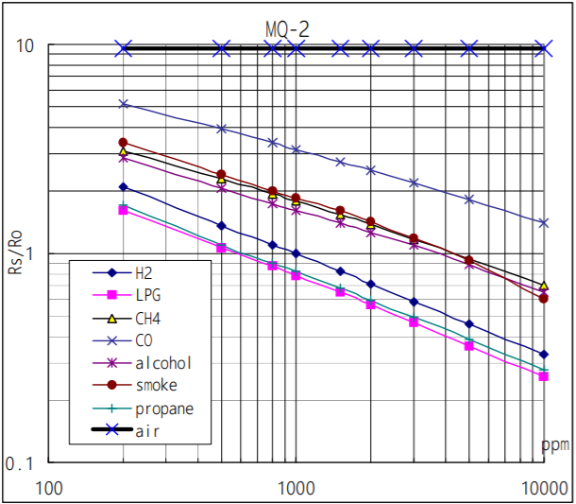
Sensitivity characteristics of the MQ-2 for several gases. in their: Temp: 20℃, Humidity: 65% , O2 concentration 21% , RL=5kΩ , Ro: sensor resistance at 1000ppm of H2 in the clean air. Rs:Sensor resistance at various concentrations of gases.
Detecting concentration
scope： 200ppm-5000ppm
LPG and propane 300ppm-5000ppm
butane 5000ppm-20000ppm
methane 300ppm-5000ppm
H2 100ppm-2000ppm

Slide 7
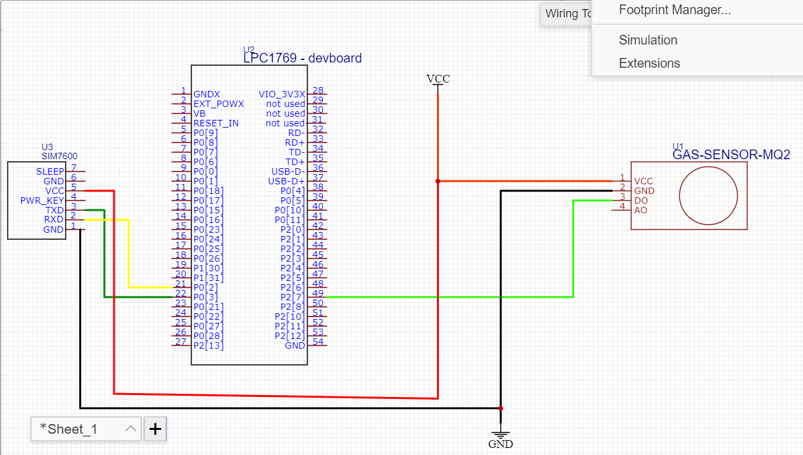
The LPC1769 pin P2[7] which is GPIO pin is connected to digital output D0 of MQ-2.

Slide 8
Steps to Interface MQ-2 Sensor with LPC1769
Connect D-Out Pin of MQ-2 Sensor with available GPIO pin.
Configure GPIO port , Enable peripheral clock of GPIO.
Setup Pin-Muxing for selected GPIO Pin.
Set Pin Direction as Input.
If Pin Status is high set variable as high else low.

Slide 9
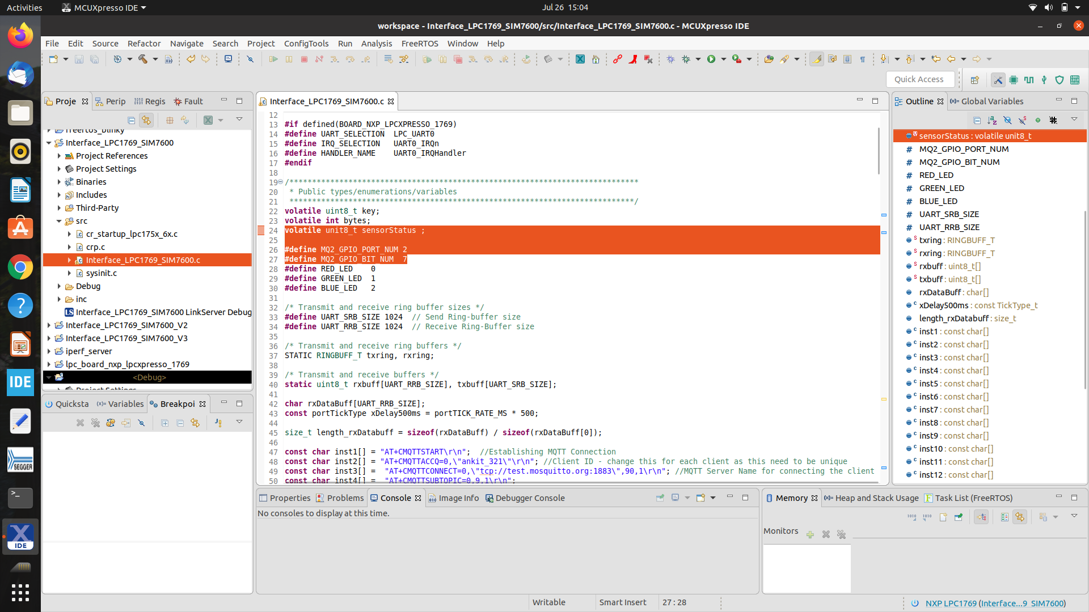

Slide 10
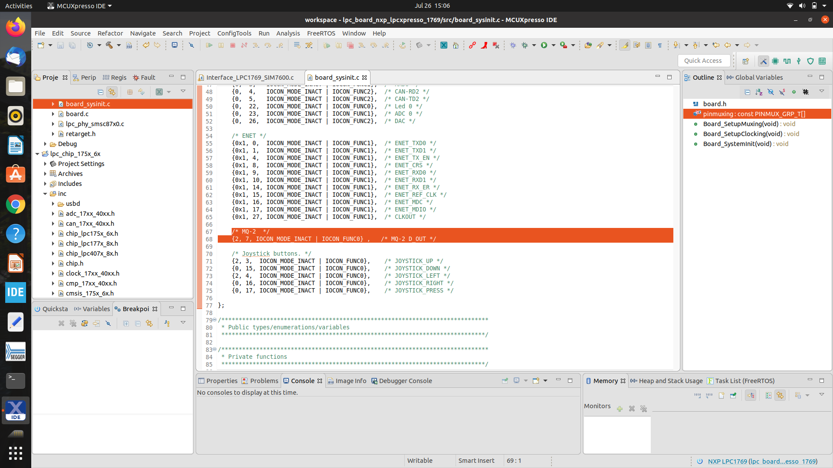

Slide 11
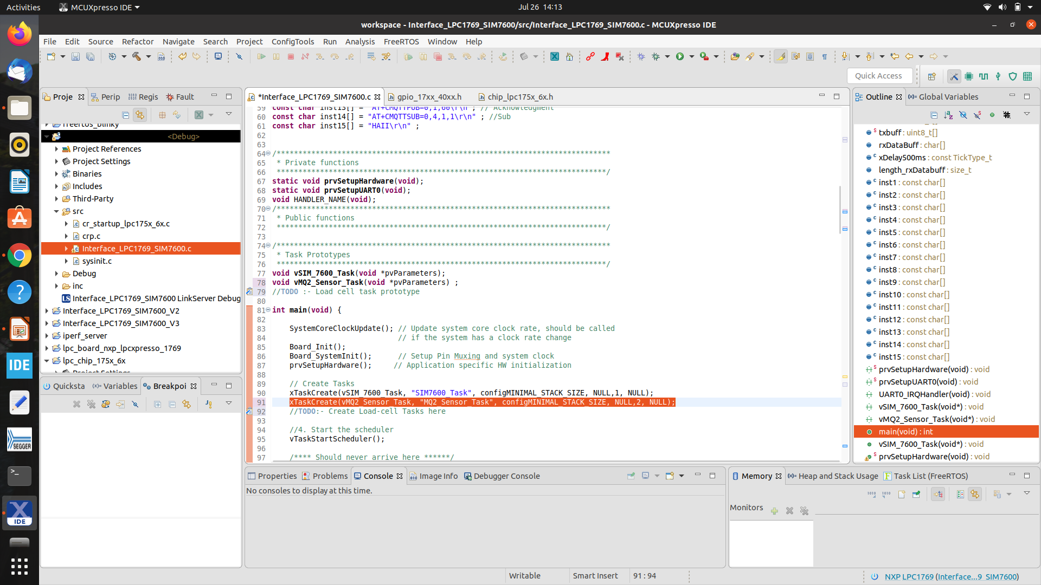

Slide 12
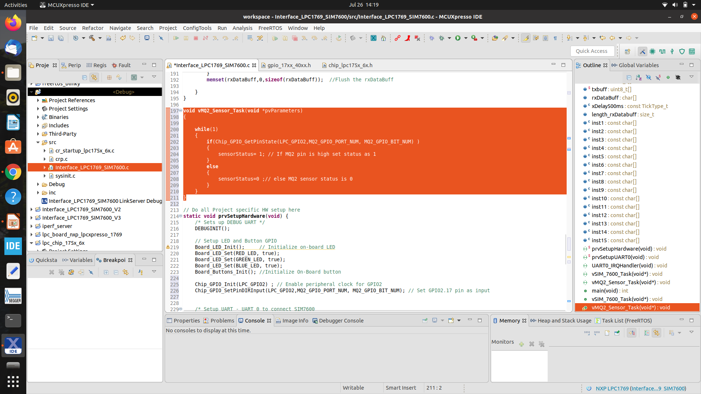

Slide 13
References
NXP Semiconductors (March 18, 2020) Datasheet of LPC1769. Retrieved from: https://www.nxp.com/docs/en/data-sheet/LPC1769_68_67_66_65_64_63.pdf
Last Minute Engineers (June 20, 2019) How MQ2 Gas/Smoke Sensor Works? & Interface it with Arduino. Retrieved from:
https://lastminuteengineers.com/mq2-gas-senser-arduino-tutorial/
HANWEI ELETRONICS CO.,LTD (July 25,2015) Datasheet of MQ-2 Gas Sensor. Retrieved from: https://www.waveshare.com/wiki/File:MQ-2.pdf

